Slide 1
Introduction to SQL
Select-From-Where Statements Multirelation Queries Subqueries

Slide 2
Why SQL?
SQL is a very-high-level language.
Say “what to do” rather than “how to do it.”
Avoid a lot of data-manipulation details needed in procedural languages like C++ or Java.
Database management system figures out “best” way to execute query.
Called “query optimization.”

Slide 3

SQL历史
SQL
Structured Query Language，结构化查询语言
1974年由Boyce和Chamberlin提出
1975~1979年IBM公司实现
目前国际标准：ANSI-99 标准
2003年添加了XML的操作...

Slide 4
SQL特点
SQL是一种介于关系代数和关系演算之间的结 构化查询语言。
SQL语言集数据查询（Data Query）、数据操 纵（Data Manipulation）、数据定义（Data Definition）、数据控制（Data Control）于一 体。
关系模型中实体和实体间的联系都用关系来表示，使 得操作符单一，每种操作只使用一个操作符。

Slide 5
SQL的特点
面向集合的操作方式
SQL语言采用集合操作方式，查询、插入、 删除、修改操作的对象都是集合。
以同一种语法结构提供两种使用方式
SQL语言既是自含式语言，又是嵌入式语言
，而且语法结构基本一致

Slide 6













SQL的特点
语言简洁，易学易 用
核心功能一共9个动词
SQL功能 | 动词
 | SELECT
 | CREATE，DROP，ALTER
 | INSERT，UPDATE，DELETE
 | GRANT，REVOKE

Slide 7
Select-From-Where Statements
SELECT desired attributes FROM one or more tables
WHERE condition about tuples of the tables

Slide 8
Our Running Example
All our SQL queries will be based on the following database schema.
Underline indicates key attributes.
Beers(name, manf) Bars(name, addr, license) Drinkers(name, addr, phone) Likes(drinker, beer) Sells(bar, beer, price) Frequents(drinker, bar)

Slide 9
Example
Using Beers(name, manf), what beers are made by Anheuser-Busch?
SELECT name
FROM Beers
WHERE manf = ’Anheuser-Busch’;

Slide 10
Result of Query
name Bud Bud Lite
Michelob
. . .
The answer is a relation with a single attribute, name, and tuples with the name of each beer by Anheuser-Busch, such as Bud.

Slide 11
Meaning of Single-Relation Query
Begin with the relation in the FROM clause.
Apply the selection indicated by the WHERE clause.
Apply the extended projection indicated by the SELECT clause.

Slide 12
Operational Semantics
name | manf
Bud | Anheuser-Busch
Include t.name in the result, if so
Check if Anheuser-Busch
Tuple-variable t loops over all tuples
12

Slide 13
Operational Semantics --- General
Think of a tuplevariable visiting each tuple of the relation mentioned in FROM.
Check if the “current” tuple satisfies the WHERE clause.
If so, compute the attributes or expressions of the SELECT clause using the components of this tuple.

Slide 14
* In SELECT clauses
When there is one relation in the FROM clause, * in the SELECT clause stands for “all attributes of this relation.”
Example: Using Beers(name, manf):
SELECT *
FROM Beers
WHERE manf = ’Anheuser-Busch’;

Slide 15
Result of Query:
name manf
Bud Bud Lite
Michelob
. . .
Anheuser-Busch Anheuser-Busch Anheuser-Busch
. . .
Now, the result has each of the attributes of Beers.

Slide 16
Renaming Attributes
If you want the result to have different attribute names, use “AS <new name>” to rename an attribute.
Example: Using Beers(name, manf): SELECT name AS beer, manf FROM Beers
WHERE manf = ’Anheuser-Busch’

Slide 17
Result of Query:
beer Bud Bud Lite
Michelob
. . .
manf
Anheuser-Busch Anheuser-Busch Anheuser-Busch
. . .

Slide 18
Expressions in SELECT Clauses
Any expression that makes sense can appear as an element of a SELECT clause.
Example: Using Sells(bar, beer, price):
SELECT bar, beer,
price*114 AS priceInYen FROM Sells;

Slide 19
Result of Query
bar | beer | priceInYen
Joe’s | Bud | 285
Sue’s | Miller | 342
… | … | …

Slide 20
Example: Constants常量 as Expressions
Using Likes(drinker, beer):
SELECT drinker,
’likes Bud’ AS whoLikesBud FROM Likes
WHERE beer = ’Bud’;

Slide 21
Result of Query
drinker whoLikesBud
Sally Fred
…
likes Bud likes Bud
…

Slide 22
Example: Information Integration集成
We often build “data warehouses” from the data at many “sources.”
Suppose each bar has its own relation Menu(beer, price) .
To contribute to Sells(bar, beer, price) we need to query each bar and insert the name of the bar.

Slide 23
Information Integration --- (2)
For instance, at Joe’s Bar we can issue the query:
SELECT ’Joe’’s Bar’, beer, price
FROM Menu;

Slide 24
Complex Conditions in WHERE Clause
Boolean operators AND, OR, NOT.
Comparisons =, <>, <, >, <=, >=.
And many other operators that produce boolean-valued results.

Slide 25
Example: Complex Condition
Using Sells(bar, beer, price), find the price Joe’s Bar charges for Bud:
SELECT price FROM Sells
WHERE bar = ’Joe’’s Bar’ AND beer = ’Bud’;

Slide 26
predicate
使用WHERE子句
查询条件 | 谓词
比 较 | =,>,<,>=,<=,!=,<>,!>,!<,NOT
确定范围 | BETWEEN…AND…
确定集合 | IN
字符匹配 | LIKE
空 值 | IS NULL
多重条件 | AND,OR,NOT

Slide 27
Patterns模式
A condition can compare a string to a pattern by:
<Attribute> LIKE <pattern> or
<Attribute> NOT LIKE <pattern>
Pattern is a quoted string with % = “any string”; _ = “any character.”
27

Slide 28
Patterns
% 0~任意多个字符
_ 任意单个字符
[] 集合范围内的任意单个字符
[^] 不在集合范围内的任意单个字符 […-…] 前一字符至后一字符中的任一字符 ESCAPE 取消后面通配字符的通配作用

Slide 29
Example: LIKE
Using Drinkers(name, addr, phone) find the drinkers with exchange 555:
SELECT name FROM Drinkers
WHERE phone LIKE ’%555-_ _ _ _’;
29

Slide 30
LIKE
like ‘baby%’ like ‘%baby%’ like ‘ba_by’ like ‘[abc]%’
like ‘[^p]en%’
like ‘%baby’ like ‘_en’ like ‘baby_’
like ‘[a-c]ing’ like p[^q]en%’
like ‘DB\_Design’ESCAPE ‘ \’

Slide 31






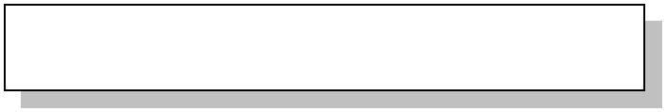
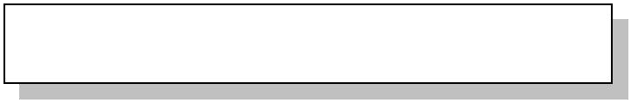


BETWEEN AND
SELECT beer beername, price FROM Sells
WHERE price BETWEEN 10 AND 20
Chai | 18
Chang | 19
Aniseed Syrup | 10
Genen Shouyu | 15.5
Pavlova | 17.45
Sir Rodney’s Scones | 10
… … 日
2020年9月23

Slide 32

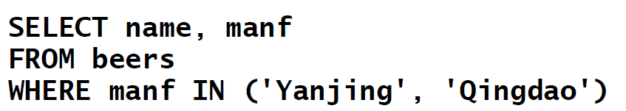




IN
draft draught draft draught
Yanjing Yanjing Qingdao Qingdao

Slide 33
NULL Values
Tuples in SQL relations can have NULL as a value for one or more components.
Meaning depends on context. Two common cases:
Missingvalue: e.g., we know Joe’s Bar has some address, but we don’t know what it is.
Inapplicable不适用: e.g., the value of attribute spouse for an unmarried person.

Slide 34
Comparing NULL’s to Values
The logic of conditions in SQL is really 3- valued logic: TRUE, FALSE, UNKNOWN.
Comparing any value (including NULL itself) with NULL yields UNKNOWN.
A tuple is in a query answer iff the WHERE clause is TRUE (not FALSE or UNKNOWN).

Slide 35
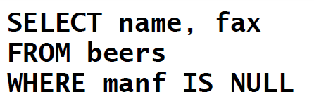
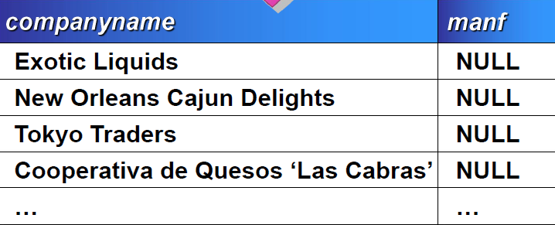
NULL

Slide 36
Three-Valued Logic
To understand how AND, OR, and NOT work in 3-valued logic, think of TRUE = 1, FALSE = 0, and UNKNOWN = ½.
AND = MIN; OR = MAX, NOT(x) = 1-x.
Example:
TRUE AND (FALSE OR NOT(UNKNOWN)) = MIN(1, MAX(0, (1 - ½ ))) =
MIN(1, MAX(0, ½ )) = MIN(1, ½ ) = ½.
36

Slide 37
Surprising Example
From the following Sells relation:
bar beer Joe’s Bar Bud
SELECT bar FROM Sells
price NULL
WHERE price < 2.00 OR price >= 2.00;
UNKNOWN UNKNOWN
UNKNOWN
37

Slide 38
Reason: 2-Valued Laws != 3-Valued Laws
Some common laws, like commutativity of AND, hold in 3-valued logic.
But not others, e.g., the law of the excluded middle: pOR NOT p= TRUE.
When p= UNKNOWN, the left side is MAX( ½, (1 – ½ )) = ½ != 1.

Slide 39
Multirelation Queries多关系查询
Interesting queries often combine data from more than one relation.
We can address several relations in one query by listing them all in the FROM clause.
Distinguish attributes of the same name by “<relation>.<attribute>” .

Slide 40
Example: Joining Two Relations
Using relations Likes(drinker, beer) and Frequents(drinker, bar), find the beers liked by at least one person who frequents Joe’s Bar.
SELECT beer
FROM Likes, Frequents
WHERE bar = ’Joe’’s Bar’ AND Frequents.drinker =
Likes.drinker;

Slide 41
Formal Semantics形式语义
Almost the same as for single-relation queries:
Start with the product of all the relations in the FROM clause.
Apply the selection condition from the WHERE clause.
Project onto the list of attributes and expressions in the SELECT clause.

Slide 42
Operational Semantics操作语义
Imagine one tuple-variable for each relation in the FROM clause.
These tuple-variables visit each combination of tuples, one from each relation.
If the tuple-variables are pointing to tuples that satisfy the WHERE clause, send these tuples to the SELECT clause.

Slide 43
Example
drinker
bar
drinker
beer
tv1
tv2
Sally
Bud
Sally
Joe’s
check for Joe
Likes
Frequents
check these are equal
to output

Slide 44
Explicit Tuple-Variables 显式元组变量
Sometimes, a query needs to use two copies of the same relation.
Distinguish copies by following the relation name by the name of a tuple- variable, in the FROM clause.
It’s always an option to rename relations this way, even when not essential.

Slide 45
Example: Self-Join
From Beers(name, manf), find all pairs of beers by the same manufacturer.
Do not produce pairs like (Bud, Bud).
Produce pairs in alphabetic order, e.g. (Bud, Miller), not (Miller, Bud).
SELECT b1.name, b2.name FROM Beers b1, Beers b2
WHERE b1.manf = b2.manf AND b1.name < b2.name;

Slide 46
Subqueries子查询
A parenthesized SELECT-FROM-WHERE statement (subquery) can be used as a value in a number of places, including FROM and WHERE clauses.
Example: in place of a relation in the FROM clause, we can use a subquery and then query its result.
Must use a tuple-variable to name tuples of the result.

Slide 47
Example: Subquery in FROM
Find the beers liked by at least one person
who frequents Joe’s Bar.
SELECT beer
Drinkers who frequent Joe’s Bar
FROM Likes, (SELECT drinker FROM Frequents
WHERE bar = ’Joe’’s Bar’)JD WHERE Likes.drinker = JD.drinker;

Slide 48
Subqueries That Return One Tuple
If a subquery is guaranteed to produce one tuple, then the subquery can be used as a value.
Usually, the tuple has one component.
A run-time error occurs if there is no tuple or more than one tuple.

Slide 49
Example: Single-Tuple Subquery
Using Sells(bar, beer, price), find the bars that serve Miller for the same price Joe charges for Bud.
Two queries would surely work:
Find the price Joe charges for Bud.
Find the bars that serve Miller at that price.

Slide 50
Query + Subquery Solution
SELECT bar FROM Sells
WHERE beer = ’Miller’ AND price =
(SELECT price
FROM Sells
WHERE bar = ’Joe’’s Bar’ AND beer = ’Bud’);
The price at which Joe sells Bud

Slide 51
The IN Operator
<tuple> IN (<subquery>) is true if and only if the tuple is a member of the relation produced by the subquery.
Opposite: <tuple> NOT IN (<subquery>).
IN-expressions can appear in WHERE clauses.

Slide 52
Example: IN
Using Beers(name, manf) and Likes(drinker, beer), find the name and manufacturer of each beer that Fred likes.
SELECT *
FROM Beers WHERE name IN
(SELECT beer
FROM Likes
WHERE drinker = ’Fred’
The set of beers Fred likes
);

Slide 53
Remember These From Lecture #1?
SELECT a FROM R, S
WHERE R.b = S.b;
SELECT a FROM R
WHERE b IN (SELECT b FROM S);

Slide 54
IN is a Predicate谓语 About R’s Tuples
SELECT a FROM R WHERE b IN
Two 2’s
(SELECT b FROM S)
;
a b
1 2
b c
2 5
(1,2) satisfies the condition;
1 is output once.
3 4
R
2 6
S
One loop, over the tuples of R

Slide 55
This Query Pairs Tuples from R, S
SELECT a FROM R, S
WHERE R.b = S.b;
a b
1 2
b c
2 5
(1,2) with (2,5)
and (1,2) with
(2,6) both satisfy the condition;
1 is output twice.
3 4
R
2 6
S
Double loop, over the tuples of R and S

Slide 56


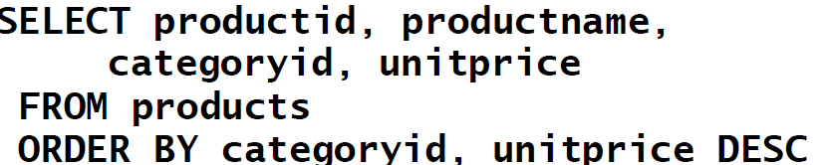


















ORDR BY
38 | Cote de Blaye | 1 | 263.5000
43 | Ipoh Coffee | 1 | 46.0000
2 | Chang | 1 | 19.0000
… | … | … | …
63 | Vegie-spread | 2 | 43.9000
8 Northwoods Cranberry Sauce2 40.0000
61 | Sirop d'érable | 2 | 28.5000
…2020年9月23日 | … | … | …

Slide 57
The Exists Operator
EXISTS(<subquery>) is true if and only if the subquery result is not empty.
Example: From Beers(name, manf) , find those beers that are the unique beer by their manufacturer.
57

Slide 58
EXISTS
带有EXISTS谓词的子查询
全称量词∀
SQL语言中没有全称量词∀，但可以进行谓词等 价转换，使用存在量词表示，并进行适当的查询 o (∀ x)P ≡ ¬ (∃ x ( ¬ P ))
蕴涵逻辑运算
SQL语言中没有蕴涵逻辑运算，但可以进行谓词 等价转换，并进行适当的查询。
p → q ≡ ¬ p ∨ q
2020年9月23日

Slide 59
EXISTS
带有EXISTS谓词的子查询（续）
EXISTS代表存在量词∃。
Use with Correlated Subqueries关联子查询
Determine Whether Data Exists in a List of Values
2020年9月23日

Slide 60
Example: EXISTS
SELECT name FROM Beers b1
WHERE NOT EXISTS (
Notice scope rule: manf refers to closest nested FROM with
a relation having that attribute.
SELECT *
FROM Beers
WHERE manf = b1.manf AND name <> b1.name);
Set of beers with the same manf as b1, but not the same beer
Notice the SQL “not equals” operator
60

Slide 61
The Operator ANY
x= ANY(<subquery>) is a boolean condition that is true iff x equals at least one tuple in the subquery result.
⬥ = could be any comparison operator.
Example: x>= ANY(<subquery>) means x is not the uniquely smallest tuple produced by the subquery.
Note tuples must have one component only.
61

Slide 62
ANY
带有ANY（SOME）谓词的子查询
谓词 | 含义
> ANY | 大于子查询结果的某个值
>=ANY | 大于等于子查询结果的某个值
< ANY | 小于子查询结果的某个值
<=ANY | 小于等于子查询结果的某个值
= ANY | 等于子查询结果的某个值
<>ANY | 不等于子查询结果的某个值

Slide 63





ANY
带有ANY（SOME）谓词的子查询
Example 1
SELECT * FROM xs
WHERE csrq < ANY
(SELECT csrq FROM xs) AND xb=‘男’
Example 2
SELECT * FROM xs
WHERE csrq <
(SELECT MAX(csrq) FROM xs)
AND xb=‘男’
2020年9月23日

Slide 64
The Operator ALL
x<> ALL(<subquery>) is true iff for every tuple t in the relation, x is not equal to t.
That is, x is not in the subquery result.
<> can be any comparison operator.
Example: x>= ALL(<subquery>) means there is no tuple larger than x in the subquery result.
64

Slide 65
ALL
带有ALL谓词的子查询
谓词 | 含义
> ALL | 大于子查询结果的所有值
>=ALL | 大于等于子查询结果的所有值
< ALL | 小于子查询结果的所有值
<=ALL | 小于等于子查询结果的所有值
= ALL | 等于子查询结果的所有值（无意义）
<>ALL | 不等于子查询结果的所有值

Slide 66
Example: ALL
From Sells(bar, beer, price), find the beer(s) sold for the highest price.
SELECT beer
price from the outer
FROM Sells
WHERE price >= ALL( SELECT price FROM Sells);
Sells must not be less than any price.
66

Slide 67



ALL
Example 1
SELECT * FROM xs
WHERE csrq >= ALL
(SELECT csrq FROM xs) AND xb=‘女’
Example 2
SELECT * FROM xs
WHERE csrq >=
(SELECT MAX(csrq) FROM xs)
AND xb=‘女’
2020年9月23日

Slide 68
Union, Intersection, and Difference
Union, intersection, and difference of relations are expressed by the following forms, each involving subqueries:
(<subquery>) UNION (<subquery>)
(<subquery>) INTERSECT (<subquery>)
(<subquery>) EXCEPT (<subquery>)

Slide 69
Example: Intersection交集
Using Likes(drinker, beer), Sells(bar, beer, price), and Frequents(drinker, bar), find the drinkers and beers such that:
The drinker likes the beer, and
The drinker frequents at least one bar that sells the beer.

Slide 70
Solution
Notice trick: subquery is really a stored table.
The drinker frequents a bar that sells the beer.
(SELECT * FROM Likes)
INTERSECT
(SELECT drinker, beer
FROM Sells, Frequents
WHERE Frequents.bar = Sells.bar
);

Slide 71
Bag Semantics
Although the SELECT-FROM-WHERE statement uses bag semantics, the default for union, intersection, and difference is set semantics.
That is, duplicates are eliminated as the operation is applied.消除重复项

Slide 72
Motivation: Efficiency
When doing projection, it is easier to avoid eliminating duplicates.
Just work tuple-at-a-time.
For intersection or difference, it is most efficient to sort the relations first.
At that point you may as well eliminate the duplicates anyway.

Slide 73
Controlling Duplicate Elimination
Force the result to be a set by SELECT DISTINCT . . .
Force the result to be a bag (i.e., don’t eliminate duplicates) by ALL, as in
. . . UNION ALL . . .

Slide 74
Example: DISTINCT不同的
From Sells(bar, beer, price), find all the different prices charged for beers:
SELECT DISTINCT price
FROM Sells;
Notice that without DISTINCT, each price would be listed as many times as there were bar/beer pairs at that price.

Slide 75
Example: ALL
Using relations Frequents(drinker, bar) and Likes(drinker, beer):
(SELECT drinker FROM Frequents)
EXCEPT ALL
(SELECT drinker FROM Likes);
Lists drinkers who frequent more bars than they like beers, and does so as many times as the difference of those counts.

Slide 76
SQL SERVER的补充命令
TOP n
选取关系中的前n个元组
一般和ORDER BY组合使用
元组本质是无序的，因此该命令不是标准的
SQL命令。
基本格式：
SELECT [TOP n] [PERCENT] [WITH TIES] FROM…
2020年9月23日

Slide 77
SQL SERVER的补充命令
TOP n
SELECT TOP 5 orderid, productid, quantity FROM [order details]
ORDER BY quantity DESC
SELECT TOP 5 WITH TIES orderid, productid, quantity
FROM [order details] ORDER BY quantity DESC
2020年9月23日

Slide 78
Join Expressions
SQL provides several versions of (bag) joins.
These expressions can be stand-alone queries or used in place of relations in a FROM clause.

Slide 79
Products and Natural Joins
Natural join:
R NATURAL JOIN S;
Product:
R CROSS JOIN S;笛卡尔积
Example:
Likes NATURAL JOIN Sells;
Relations can be parenthesized subqueries, as well.

Slide 80
Theta Join
R JOIN S ON <condition>
Example: using Drinkers(name, addr) and Frequents(drinker, bar):
Drinkers JOIN Frequents ON
name = drinker;
gives us all (d,a,d,b) quadruples such that drinker d lives at address a and frequents bar b.

Slide 81
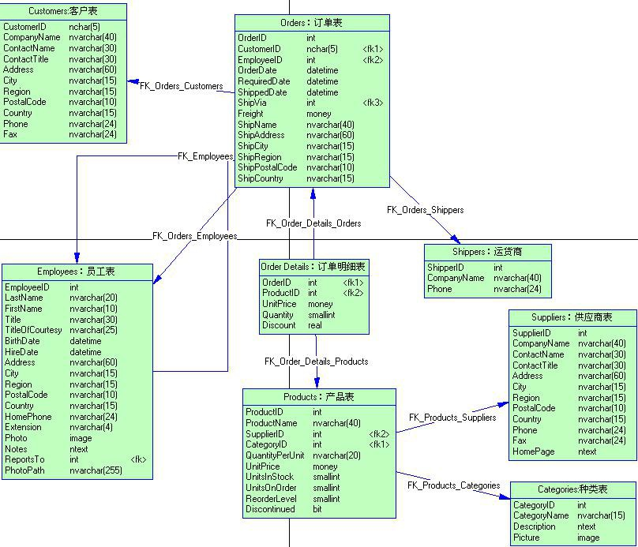
Example Database

Slide 82










































Using Inner Joins
连接SEL查ECT询buyer_name, sales.buyer_id, qty
FROM buyers INNER JOIN sales
_{自}ON_{然}bu_{连}ye_{接}rs.buyer_id = sales.buyer_id
目标列中的属性可能需要加表前缀。
buyers
Example 1
sales
Adam Barr | 1 | 1 | 2 | 15
Sean Chai | 2 | 1 | 3 | 5
Eva Corets | 3 | 4 | 1 | 37
Erin O’Melia | 4 | 3 | 5 | 11
Result
4
2
1003
Adam Barr
Adam Barr Erin O’Melia
Eva Corets Erin O’Melia
1
1
4
3
4
15
5
37
11
1003

Slide 83
Using Inner Joins
SELECT buyer_name, sales.buyer_id, qty FROM buyers , sales
WHERE buyers.buyer_id = sales.buyer_id
Example 1
buyers
sales
Adam Barr | 1 | 1 | 2 | 15
Sean Chai | 2 | 1 | 3 | 5
Eva Corets | 3 | 4 | 1 | 37
Erin O’Melia | 4 | 3 | 5 | 11
Result
4
2
1003
Adam Barr
Adam Barr Erin O’Melia
Eva Corets Erin O’Melia
1
1
4
3
4
15
5
37
11
1003

Slide 84




























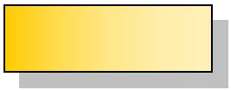
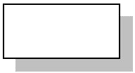
Using Outer Joins
SELECT buyer_name, sales.buyer_id, qty FROM buyers LEFT OUTER JOIN sales
ON buyers.buyer_id = sales.buyer_id
Example 1
buyers
sales
Adam Barr Sean Chai Eva Corets Erin O’Melia
1
2
3
4
1
1
4
3
4
2
3
1
5
2
15
5
37
11
1003
Result
Adam Barr
Adam Barr Erin O’Melia
Eva Corets Erin O’Melia Sean Chai
1
1
4
3
4
NULL
15
5
37
11
1003
NULL

Slide 85
Using Outer Joins
SELECT buyer_name, sales.buyer_id, qty FROM sales RIGHT OUTER JOIN buyers
ON buyers.buyer_id = sales.buyer_id
Example 1
buyers
sales
Adam Barr Sean Chai Eva Corets Erin O’Melia
1
2
3
4
1
1
4
3
4
2
3
1
5
2
15
5
37
11
1003
Result
Adam Barr
Adam Barr Erin O’Melia
Eva Corets Erin O’Melia Sean Chai
1
1
4
3
4
NULL
15
5
37
11
1003
NULL

Slide 86

























Using Cross Joins
SELECT buyer_name, qty FROM buyers
CROSS JOIN sales
Example 1
buyers
sales
Result
1
2
3
4
Adam Barr Sean Chai Eva Corets Erin O’Melia
1
1
4
3
4
2
3
1
5
2
15
5
37
11
1003
Adam Barr 15
Adam Barr 5
Adam Barr 37
Adam Barr 11
Adam Barr 1003
Sean Chai 15
Sean Chai 5
Sean Chai 37
Sean Chai 11
Sean Chai 1003
Eva Corets 15
... ...

Slide 87




















































Joining
More Than T
wo Tables
SELECT buyer_name, prod_name, qty
FROM buyers
INNER JOIN sales
Example 1
ON buyers.buyer_id = sales.buyer_id
INNER JOIN produce
ON sales.prod_id = produce.prod_id
buyers sales
produce
1
2
3
4
Adam Barr Sean Chai Eva Corets Erin O’Melia
1
1
3
4
2
2
3
1
5
2
15
5
37
11
1003
1
2
3
4
5
Apples Pears Oranges Bananas Peaches
Result
Erin O’Melia Adam Barr Erin O’Melia Adam Barr Eva Corets
Apples Pears Pears Oranges Peaches
37
15
1003
5
11

Slide 88




































Joining
a Table to
Itself
Example 3
SELECT a.buyer_id AS buyer1, a.prod_id
,b.buyer_id AS buyer2
FROM sales AS a
JOIN sales AS b
ON a.prod_id = b.prod_id WHERE a.buyer_id > b.buyer_id
sales a
sales b
1 | 2 | 15 |  | 1 | 2 | 15
1 | 3 | 5 |  | 1 | 3 | 5
4 | 1 | 37 |  | 4 | 1 | 37
3 | 5 | 11 |  | 3 | 5 | 11
4 | 2 | 1003 |  | 4 | 2 | 1003
 |  |  | Result
4
2
1

Slide 89




















Evaluating a Correlated Subquery
SELECT orderid, customerid FROM orders AS or1
WHERE 20 < (SELECT quantity
FROM [order details] AS od WHERE or1.orderid = od.orderid
AND od.productid = 23)
Example 1
Back to Step 1

Slide 90


Mimicking a JOIN Clause从句
Correlated Subqueries Can Produce the Same Result as a JOIN Clause
Joins Let the Query Optimizer Determine How to Correlate Data Most Efficiently
Example 1
SELECT DISTINCT t1.type
FROM titles AS t1 WHERE t1.type IN
(SELECT t2.type FROM titles AS t2
WHERE t1.pub_id <> t2.pub_id)

Slide 91




Mimicking a HAVING Clause
Subquery with the Same Result As a HAVING Clause
SELECT t1.type, t1.title, t1.price
Example 1
FROM titles AS t1
WHERE t1.price > ( SELECT AVG(t2.price) FROM titles AS t2
WHERE t1.type = t2.type )
Using a HAVING Clause Without a Subquery
SELECT t1.type, t1.title, t1.price
Example 2
FROM titles AS t1
INNER JOIN titles AS t2 ON t1.type = t2.type GROUP BY t1.type, t1.title, t1.price
HAVING t1.price > AVG(t2.price)

Slide 92

Using a Correlated Subquery in a HAVING Clause
Use a Correlated Subquery in a HAVING Clause of an Outer Query
SELECT t1.type FROM titles t1 GROUP BY t1.type
HAVING MAX(t1.advance) >= ALL (SELECT 2 * AVG(t2.advance) FROM titles t2
WHERE t1.type = t2.type)

Slide 93


Using the EXISTS and NOT EXISTS Clauses
Use with Correlated Subqueries
Determine Whether Data Exists in a List of Values
SQL Server Process
Outer query tests for the existence of rows
Inner query returns TRUE or FALSE
No data is produced
Example 1
SELECT lastname, employeeid FROM employees AS e
WHERE EXISTS (SELECT * FROM orders AS o
WHERE e.employeeid = o.employeeid AND o.orderdate = '9/5/2020')

